Slide 1

Eye tracking in human-computer interaction
赵辰阳

Slide 2
About me
赵辰阳
少年班学院19级
修读方向：计算机科学与技术
目前研究方向：拍照搜题的图文转换
个人能力介绍：
1.操作系统
Windows10和Linux(manjaro)双系统，熟悉Linux下命令行操作，环境配置
2.编程语言：
c，c++，面向对象的python
3.其他方面：
git，数据可视化(numpy/pandas/matplotlib/plotly)，机器学习/深度学习/计算机视觉(numpy/sklearn/pytorch)，Microsoft Office, Markdown, Latex
接触过：爬虫(requests)，RISC-V，网页模板

Slide 3

Outline
Preliminary & Feasibility
Problem Statement
Resources
Improvements

Slide 4
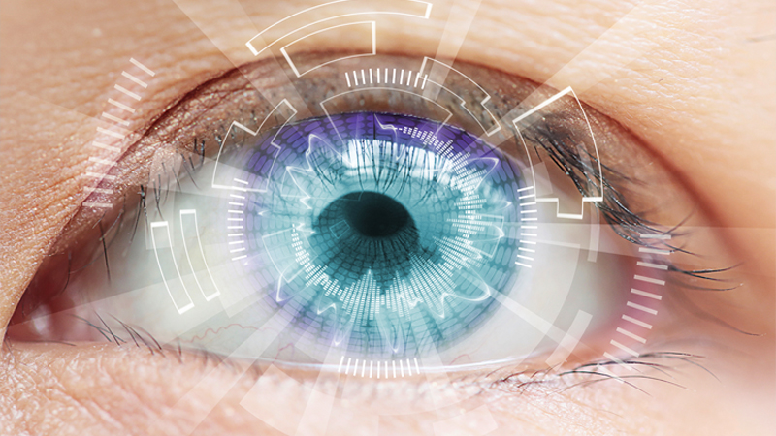

preliminary
Eye Tracking / Gaze Estimation
Human-computer Interaction

Slide 5
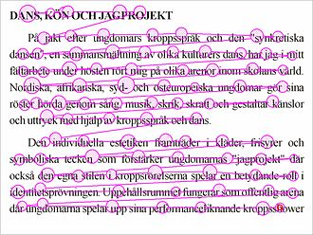
What is eye tracking?
Eye tracking is the process of measuring either the point of gaze (where one is looking) or the motion of an eye relative to the head.
An eye tracker is a device for measuring eye positions and eye movement. Eye trackers are used in research on the visual system, in psychology, in psycholinguistics, marketing, as an input device for human-computer interaction, and in product design.
From Wikipedia
An example of fixations and saccades over text. This is the typical pattern of eye movement during reading. The eyes never move smoothly over still text.
From Wikipedia

Slide 6
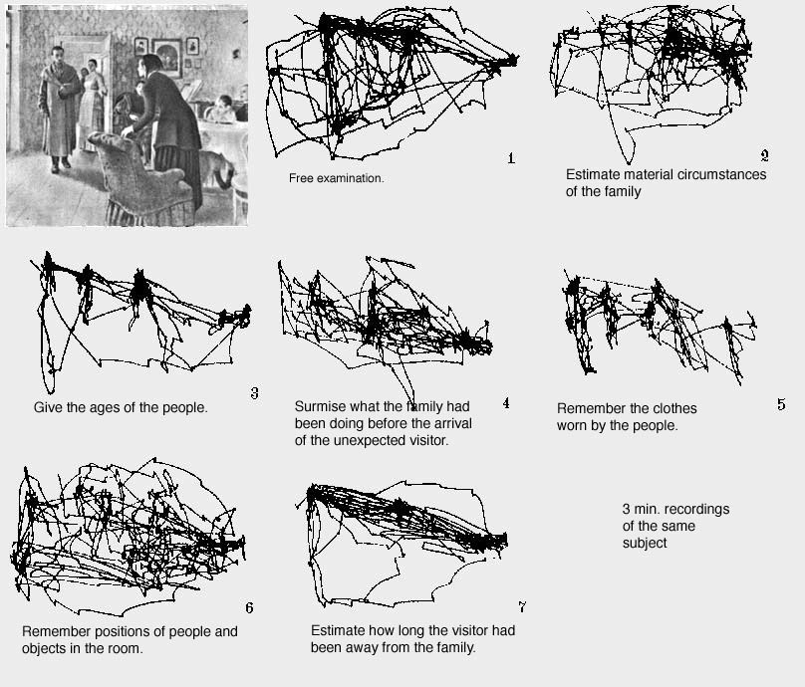
Applications
Using eye tracking to control user interfaces
Using eye tracking to control a mouse cursor
Controlling computer games by eye gaze
Gaze interaction in virtual worlds
Gaze visualizations in 3D environments
This study by Yarbus (1967) is often referred to as evidence on how the task given to a person influences his or her eye movement.
From Wikipedia
https://www.tobiipro.com/fields-of-use/user-experience-interaction/gaze-interaction/

Slide 7
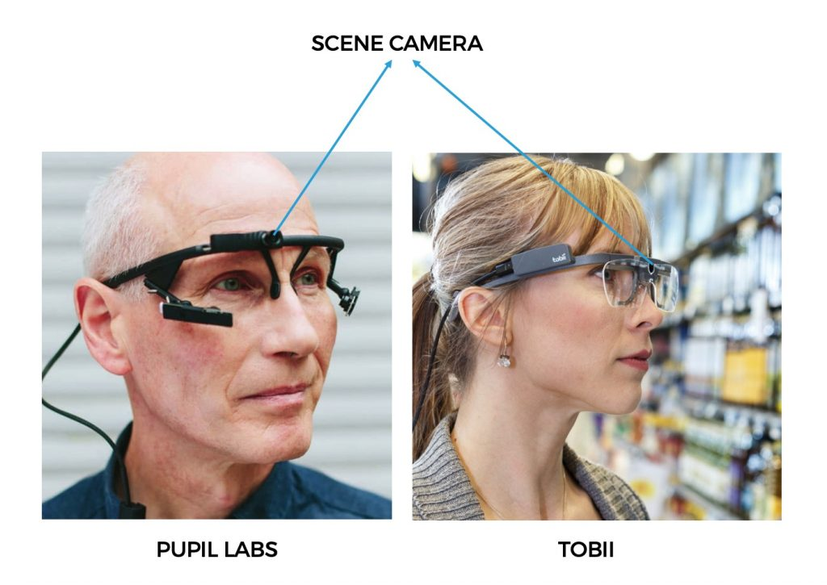
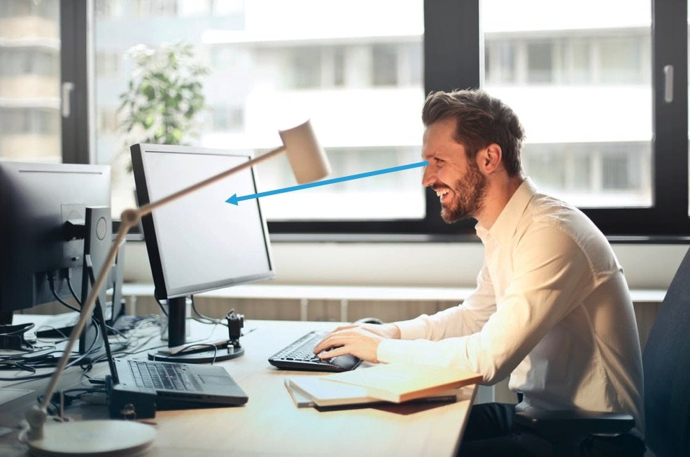
Eye tracking
Wearable
Screen-Based(Remote)
https://learnopencv.com/gaze-tracking/

Slide 8
wearable
In this setup, the person whose gaze we are interested in tracking wears a device (glasses). This device contains a camera, called the scene camera that records what the person is looking at.
https://learnopencv.com/gaze-tracking/

Slide 9
Screen based
In this setup, the person is looking at a screen (monitor) and we are interested in finding out the x and y coordinates of location on the screen where they are looking.
https://learnopencv.com/gaze-tracking/

Slide 10
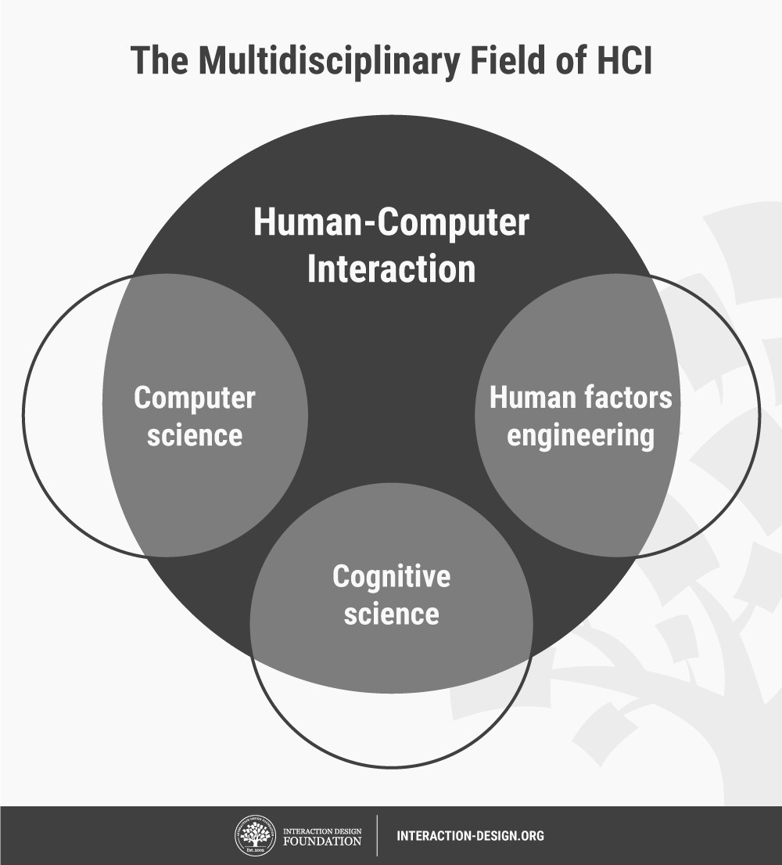
Human-computer interaction(HCI)
Human-computer interaction (HCI) is a multidisciplinary field of study focusing on the design of computer technology and, in particular, the interaction between humans (the users) and computers. While initially concerned with computers, HCI has since expanded to cover almost all forms of information technology design.
https://www.interaction-design.org/literature/topics/human-computer-interaction

Slide 11
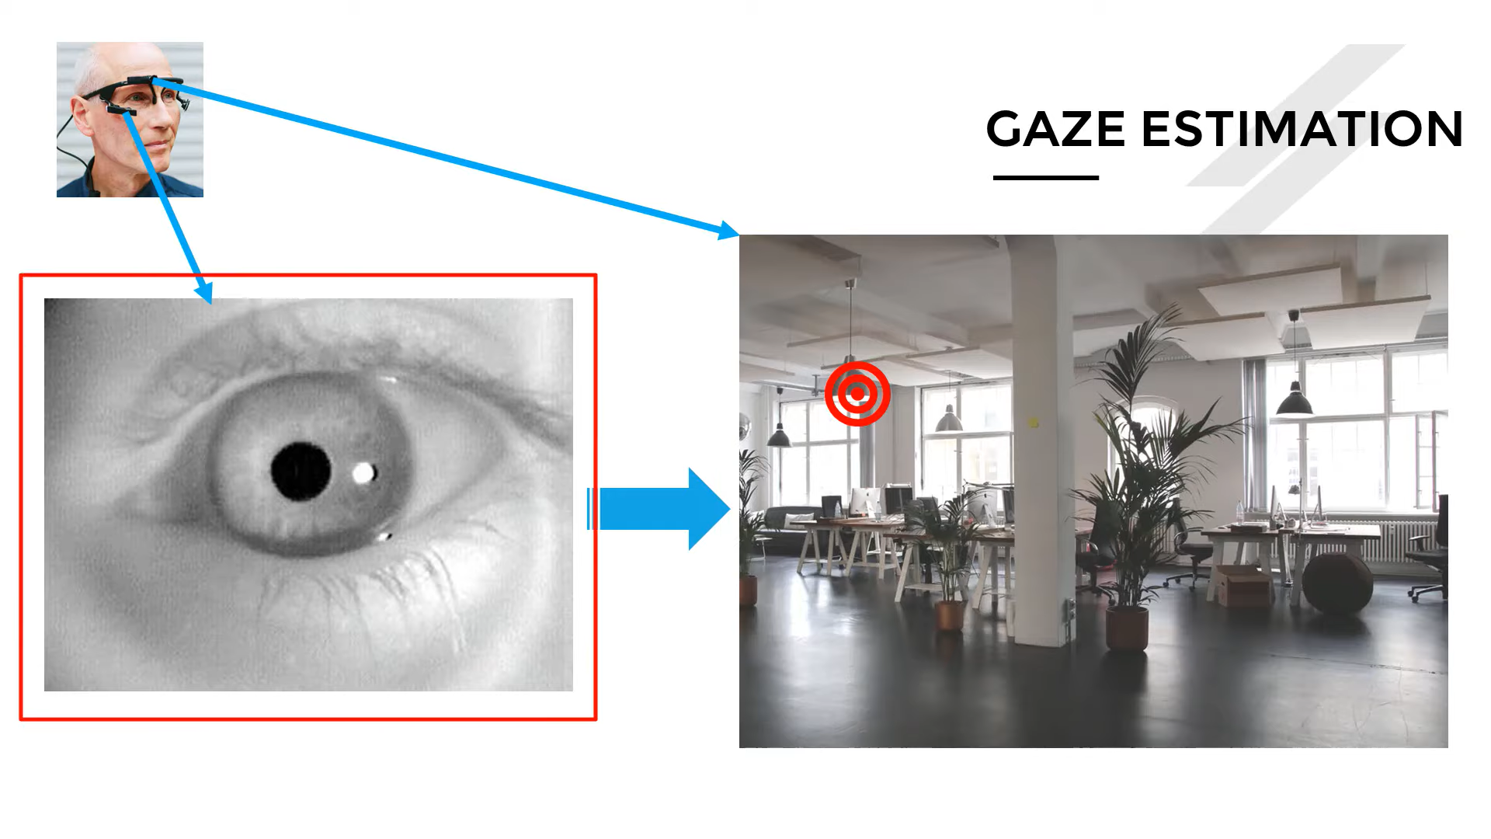
Problem statement
Eye Tracking / Gaze Estimation
Input: Real-time image of the eyes
Output: Which point(or area) on the screen the person looks at

Slide 12
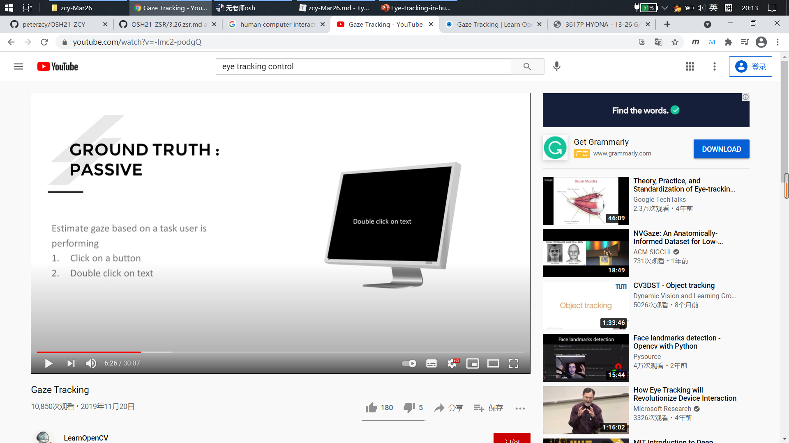

Detail: how to collect the labeled data
Active Method
Passive Method
https://learnopencv.com/gaze-tracking/

Slide 13
detail: how to collect the labeled data
Active Method
Ask the user to fixate at a point on the screen.
https://learnopencv.com/gaze-tracking/

Slide 14
Problem statement: how to collect the labeled data
Passive Method
Let the user do their daily work, and estimate when they are clicking.
https://learnopencv.com/gaze-tracking/

Slide 15
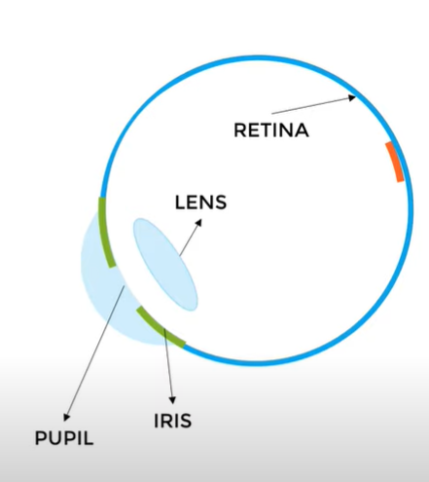
Practical problems
Camera Configuration
Pupil Detection Challenge
Eye Model and Image Formation
Pupil Detection Algorithms
Gaze Mapping
https://www.youtube.com/watch?v=-lmc2-podgQ

Slide 16
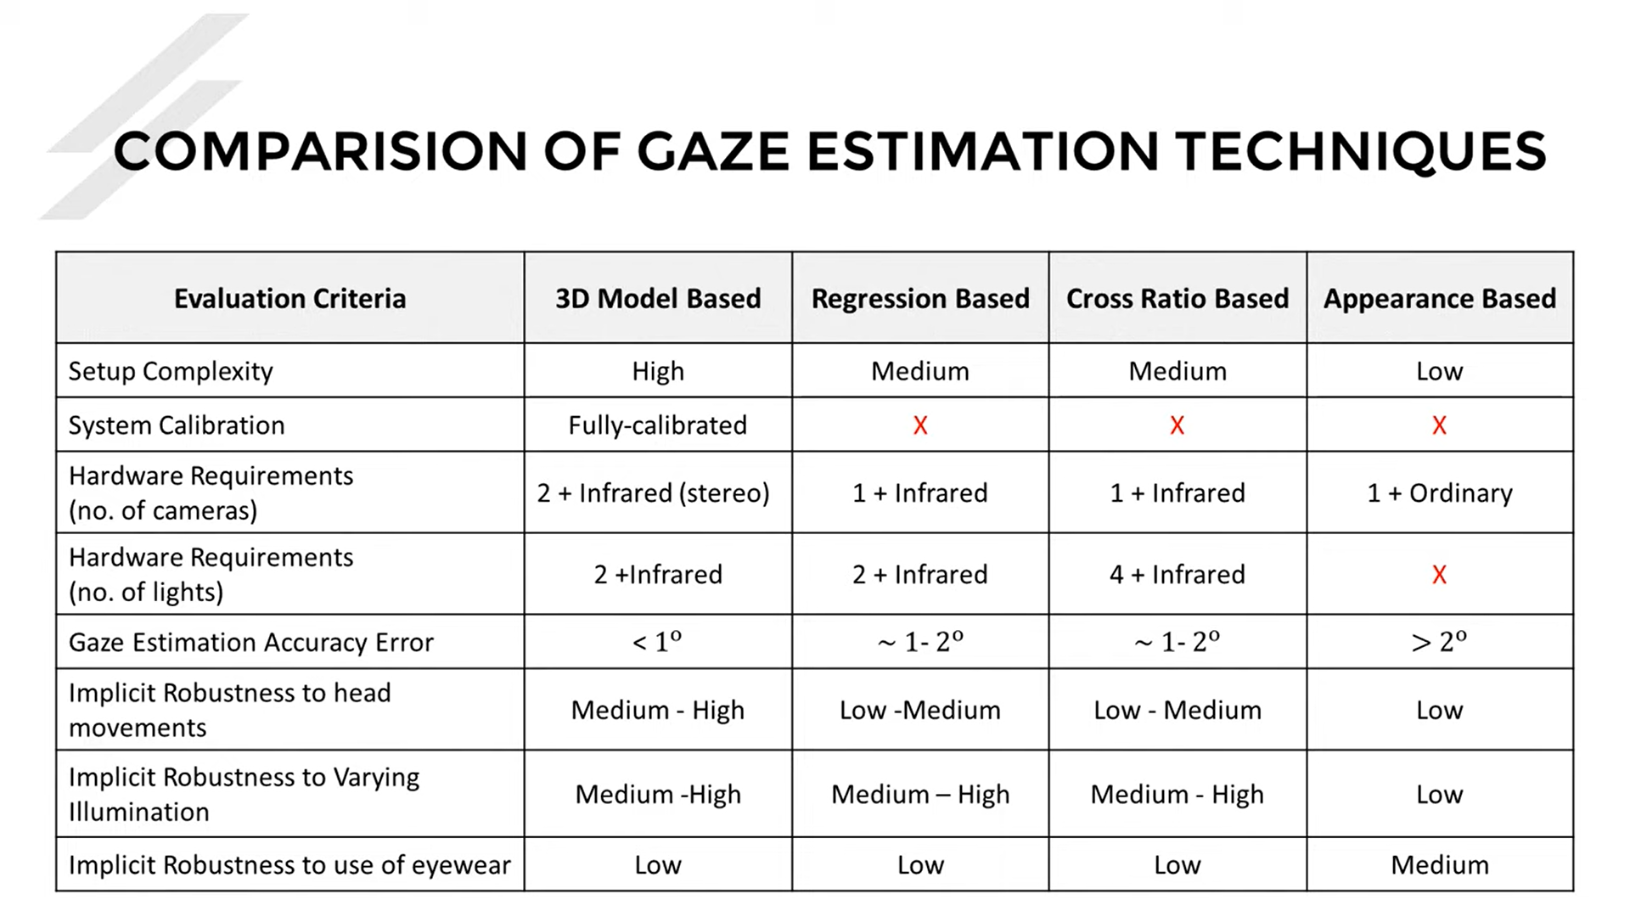
https://www.youtube.com/watch?v=-lmc2-podgQ

Slide 17
Improvements than x-oalad
Large Synthetic Data & Specified Data
Full Face & Facial Features
New CV Algorithms & Technique
Long-time Iteration

Slide 18
Resources: Papers
A Review and Analysis of Eye-Gaze Estimation Systems, Algorithms and Performance Evaluation Methods in Consumer Platforms
Deep Multitask Gaze Estimation with a Constrained Landmark-Gaze Mode
Recurrent CNN for 3D Gaze Estimation using Appearance and Shape Cues
Eye Tracking in Human–Computer Interaction and Usability Research: Ready to Deliver the Promises

Slide 19
Resources: datasets
1.Synthetic Datasets for Gaze Tracking
SYNTHESEYES (2015) by University of Cambridge
UNITYEYES (2016) by University of Cambridge
NVGaze (2019) by NVIDIA
2.Real Datasets for Gaze Tracking
UTMULTIVIEW (2013) by The University of Tokyo
EYEDIAP (2014) by Idiap Research Institute
MPIIGAZE (2015) by MPI Informatik.
GAZECAPTURE (2016) by University of Georgia, Massachusetts Institute of Technology, and MPI Informatik
RT-GENE (2018) by Imperial College London.
OpenEDS : Open Eye Dataset by Facebook
https://learnopencv.com/gaze-tracking/

Slide 20

Thanks!
赵辰阳
Email: zcy888@mail.ustc.edu.cn
Github: github.com/peterzcy

